Slide 1

Decision Tree Learning
Machine Learning

Slide 2
Decision Trees
A Decision Tree (DT) defines a hierarchy of rules to make a prediction
Root and internal nodes test rules. Leaf nodes make predictions
Decision Tree (DT) learning is about learning such a tree from labeled data
Root Node
Body
temp.
Warm
Cold
Non-mammal
An Internal Node
A Leaf Node
Gives
birth
Yes
No
Mammal
Non-mammal

Slide 3


Learning Decision Trees with Supervision
The basic idea is very simple
Recursively partition the training data into homogeneous regions
Within each group, fit a simple supervised learner (e.g., predict the majority label)
What do you mean by “homogeneous” regions?
Even though the rule within each group is simple, we are able to learn a fairly sophisticated model overall (note in this example, each rule is a simple horizontal/vertical classifier but the overall decision boundary is rather sophisticated)
A homogeneous region will have all (or a majority of) training inputs with the same/similar outputs

Slide 4
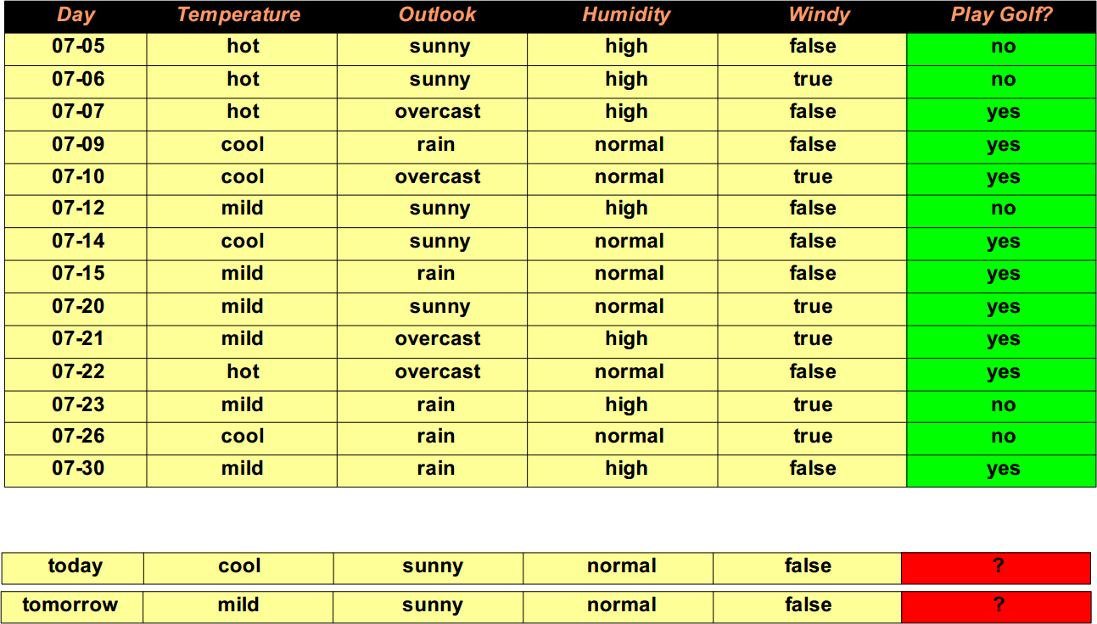
A Sample Training and Testing Dataset

Slide 5
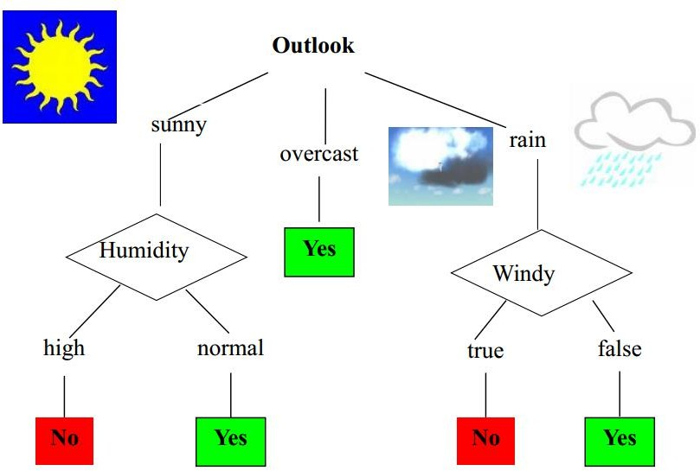
A Sample Decision Tree

Slide 6
How are decision trees used for classification?
Given a tuple, X, for which the associated class label is unknown,
The attribute values of the tuple are tested against the decision tree.
A path is traced from the root to a leaf node, which holds the class prediction for that tuple.

Slide 7
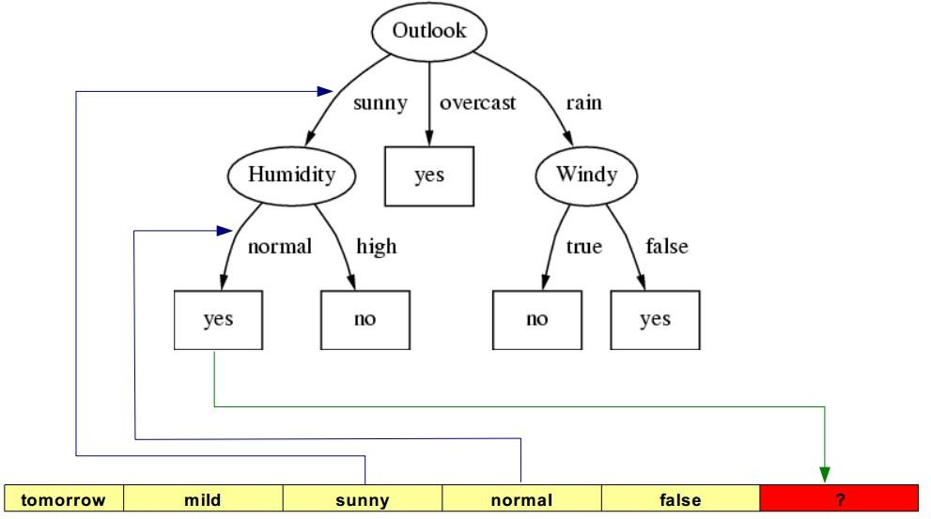
Classification using Decision Tree

Slide 8
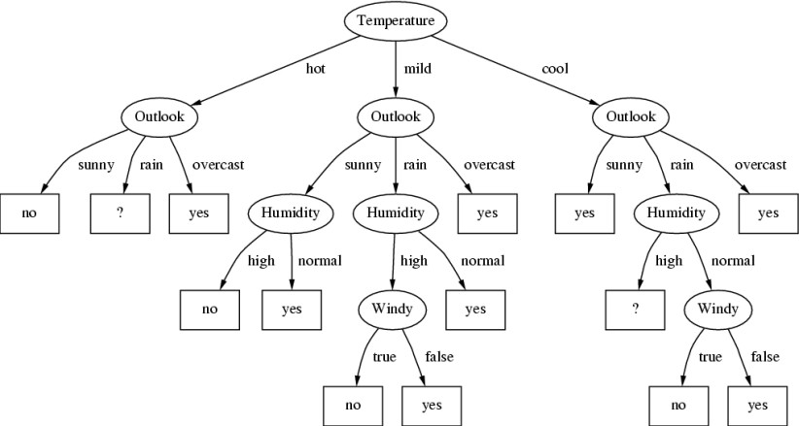
A different Decision Tree

Slide 9
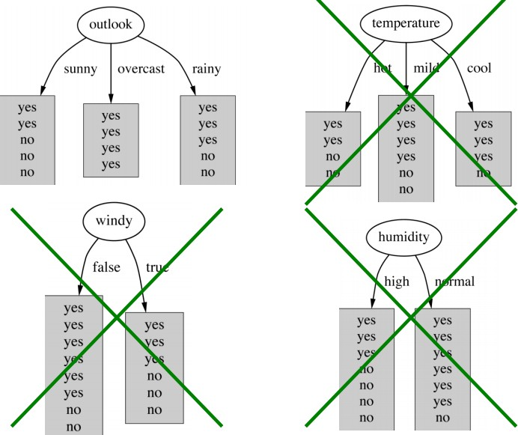
Decision Tree
Which?

Slide 10
A criterion for attribute selection
Which is the best attribute?
The one which will result in the smallest tree
Heuristic: choose the attribute that produces the “purest” nodes
Popular impurity criterion: Information Gain
– Information gain increases with the average purity of the subsets that an attribute produces
Strategy: choose attribute that results in greatest information gain

Slide 11
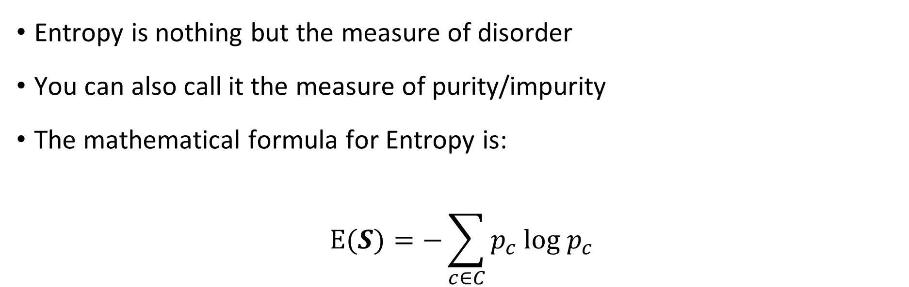
Entropy
Entropy is nothing but the measure of disorder
You can also call it the measure of purity/impurity
The mathematical formula for Entropy is:
$$E(S)=−\sum_{c∈C}{p_{c} log p_{c}}$$

Slide 12
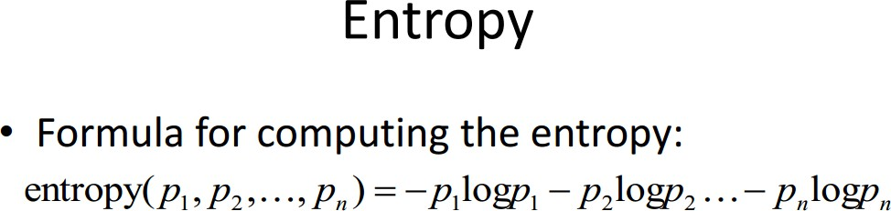

Slide 13
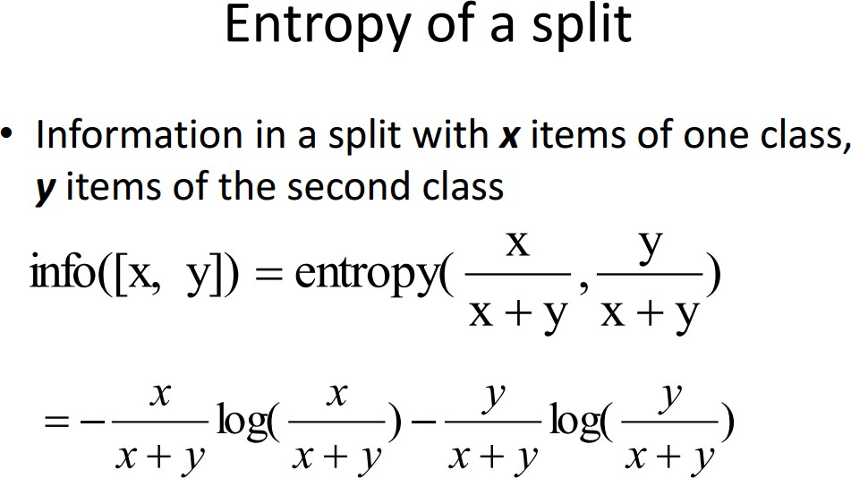

Slide 14
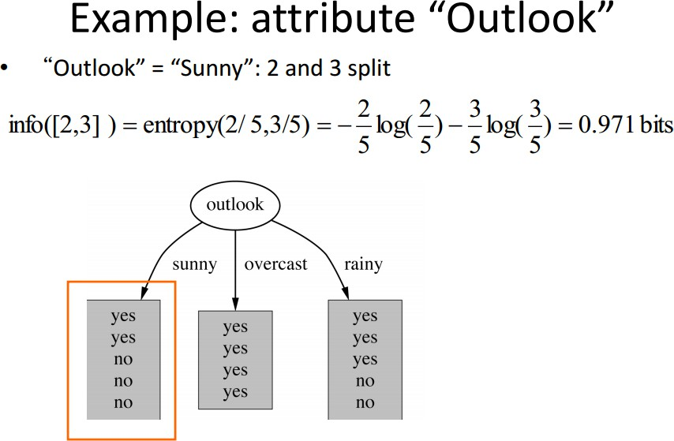

Slide 15
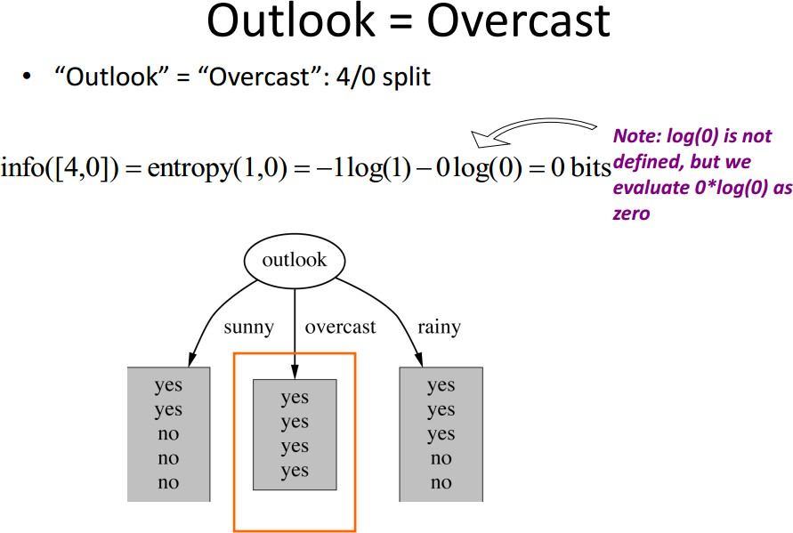

Slide 16
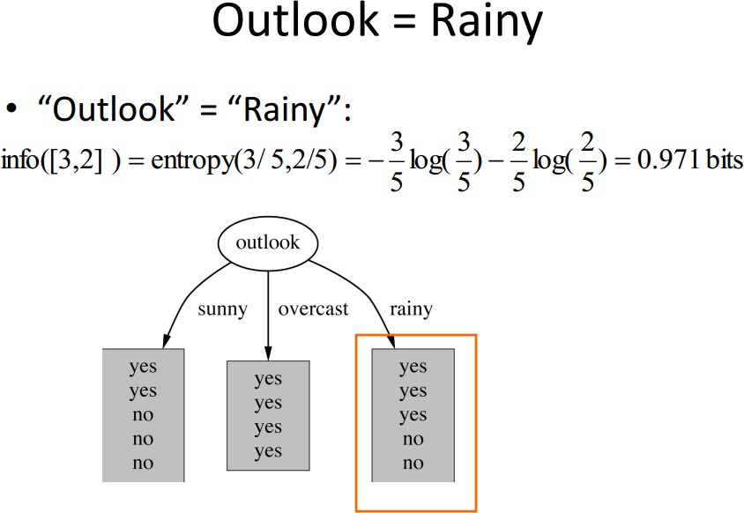

Slide 17

Information Gain
Information Gain is a metric to train decision trees
This metric measures the quality of a split
Suppose a rule splits 𝑺 into two smaller disjoint sets 𝑺1 and 𝑺2
Reduction in entropy after the split is called information gain
$IG=E\left(S\right)− \frac{\left|S_{1}\right|}{\left|S\right|}E\left(S_{1}\right)$ $− \frac{\left|S_{2}\right|}{\left|S\right|}E\left(S_{2}\right)$

Slide 18
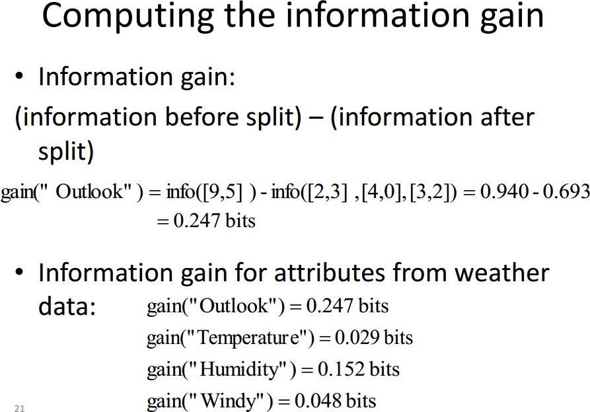

Slide 19
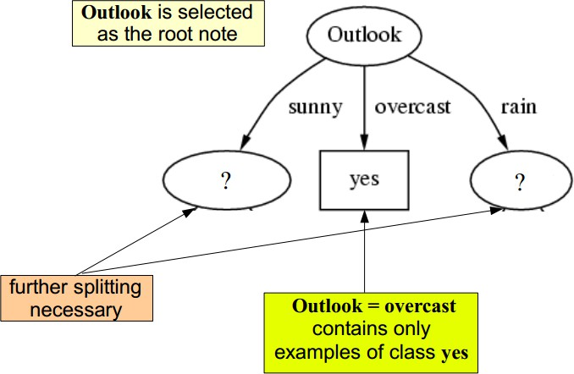

Slide 20
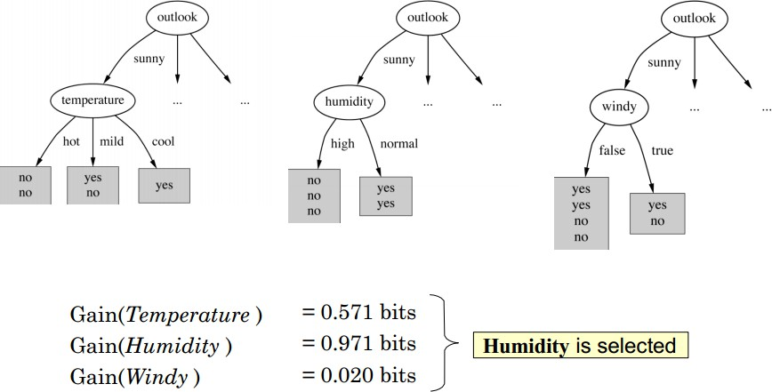

Slide 21
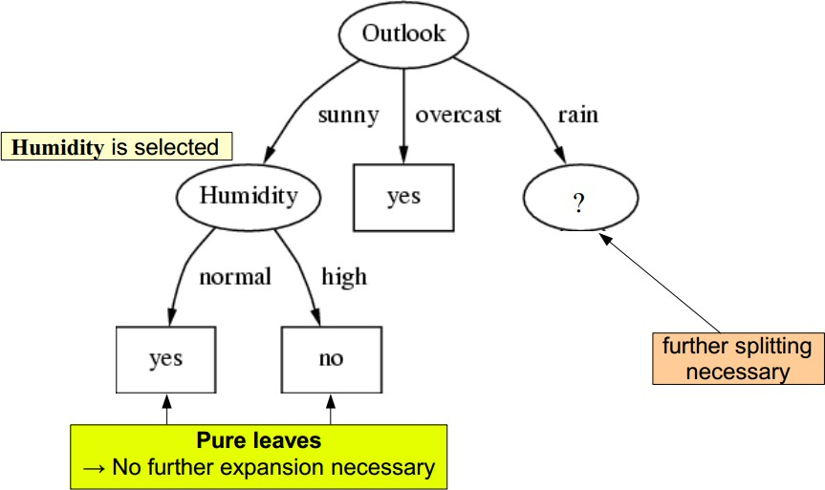

Slide 22
Thank You

Slide 23

References
[1] Han, J., Kamber, M., & Pei, J. (2012). Data mining concepts and techniques third edition. University of Illinois at Urbana-Champaign Micheline Kamber Jian Pei Simon Fraser University

